Slide 1
Managing Cyber Security in Healthcare
Name-Aniket Tambe
NUID-0016760008

Slide 2
Objective
- The main objective of this project is to manage the various aspects of cyber security in a healthcare domain.
- application revolves around the patients visiting a hospital and on whom lab tests are conducted and prescriptions are given by the doctor. The tests are done and the procedure is completed.
- In this complete cycle there are possibilities of threat at various levels like
- login by unauthorized person due to easy passwords
- Unauthorized person using idle system where some user is logged in
- illegal sharing of large amount of data
-

Slide 3
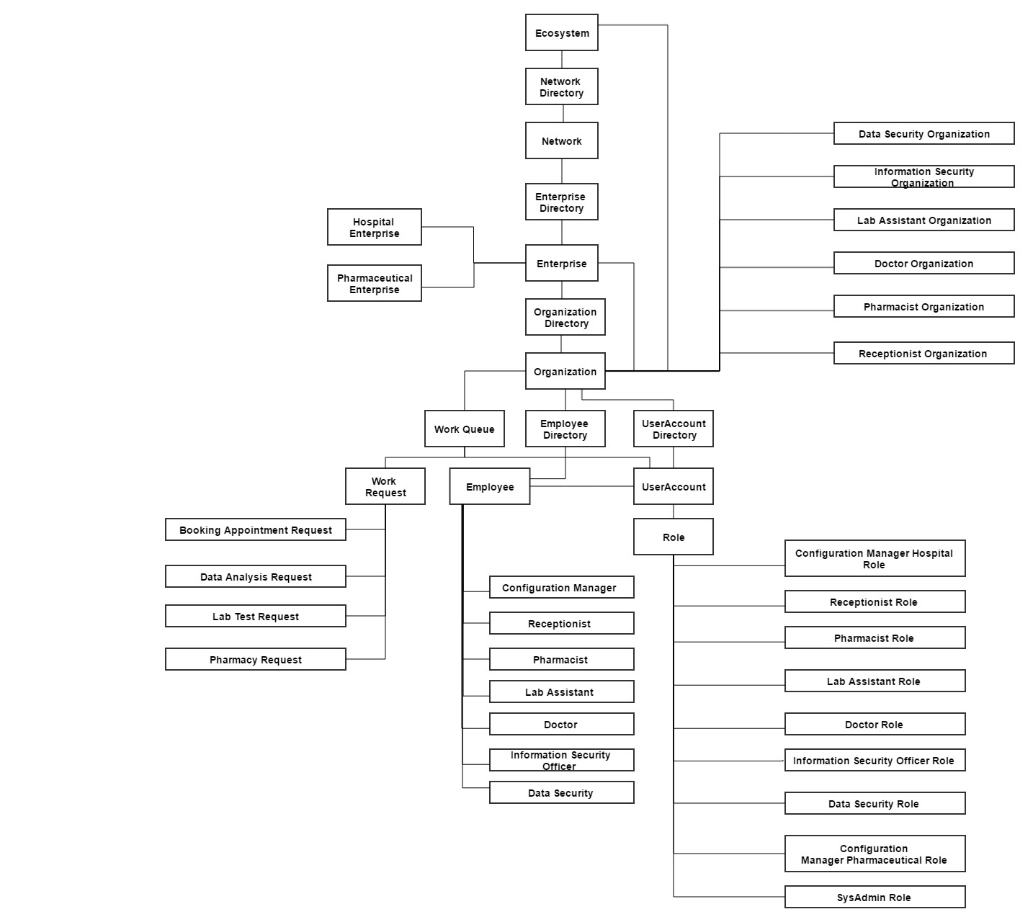
Object Model

Slide 4
Features added to prevent unwanted security breach

Slide 5
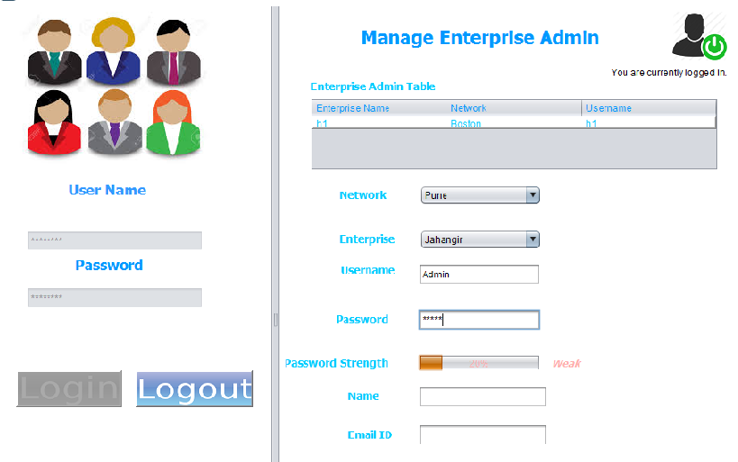
Ensure every user has a strong password

Slide 6
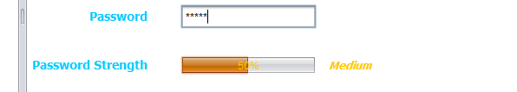

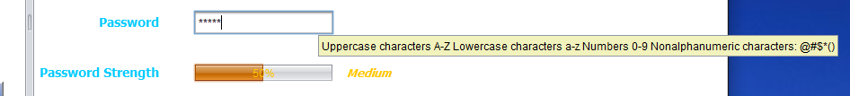
Password Strength indicator and tool tip to guide user for password requirements

Slide 7
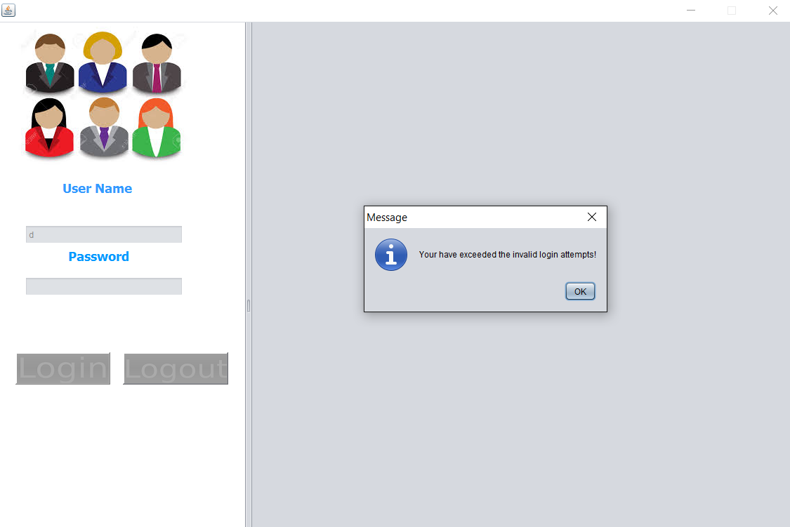
Wait timer after 3 continuous invalid login attempts

Slide 8
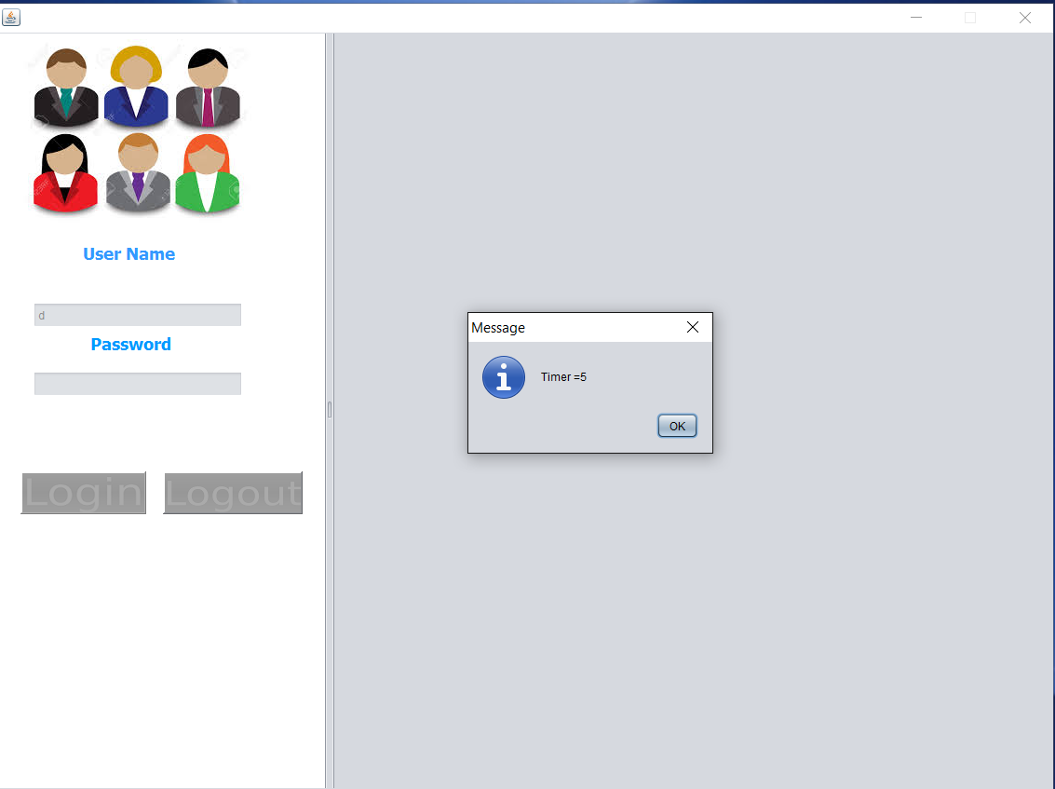

Slide 9
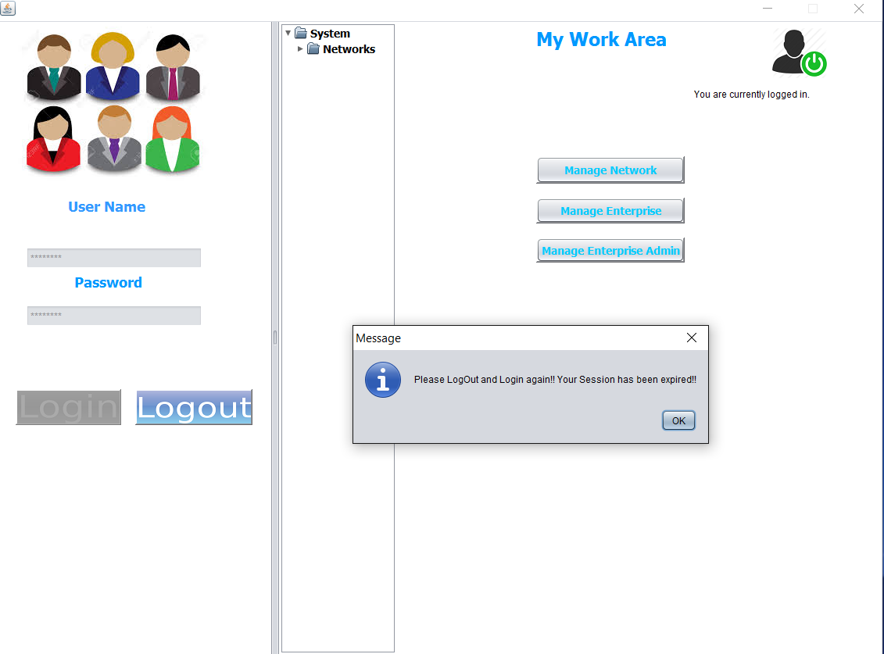
Session expires if application is left idle after login for some time

Slide 10
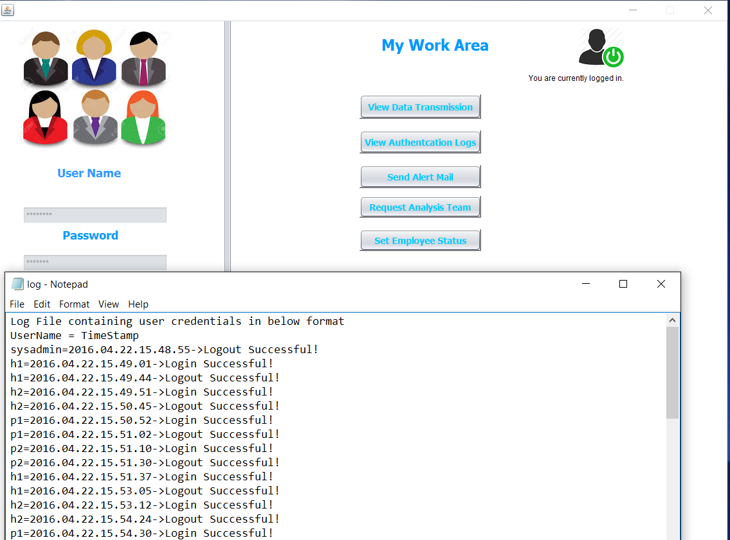
Logging file maintained for monitoring login and logout of user

Slide 11
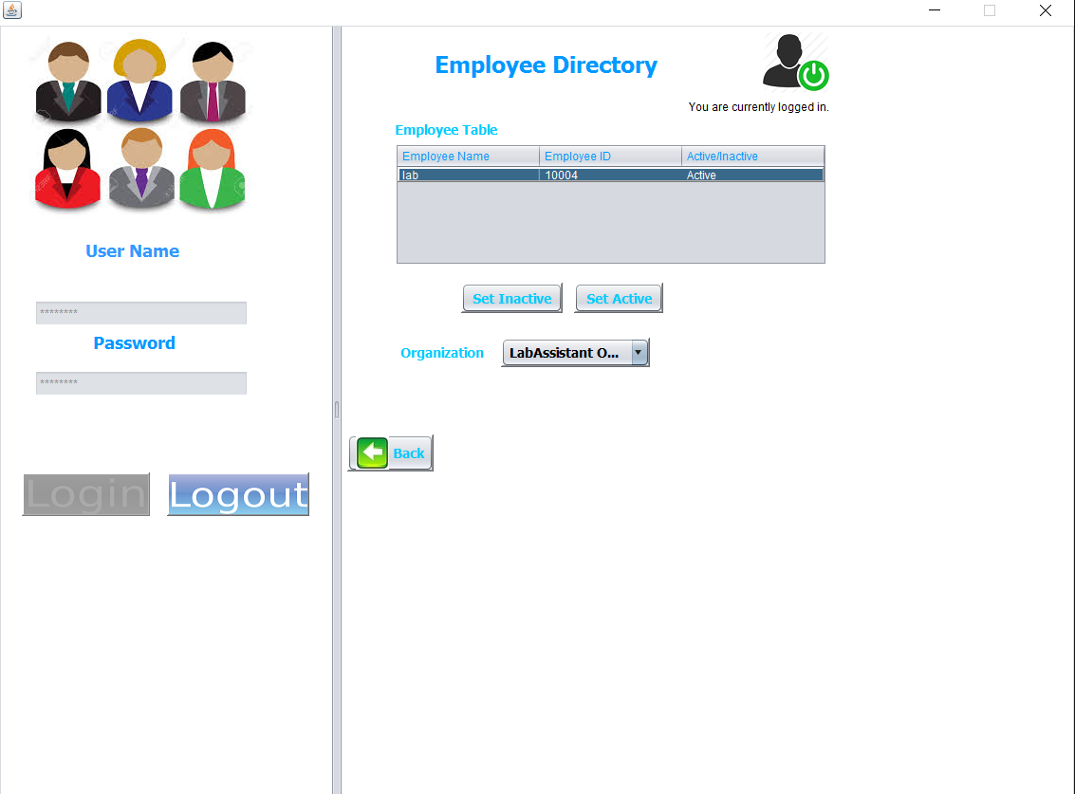
Authentication file for managing active and inactive employees

Slide 12
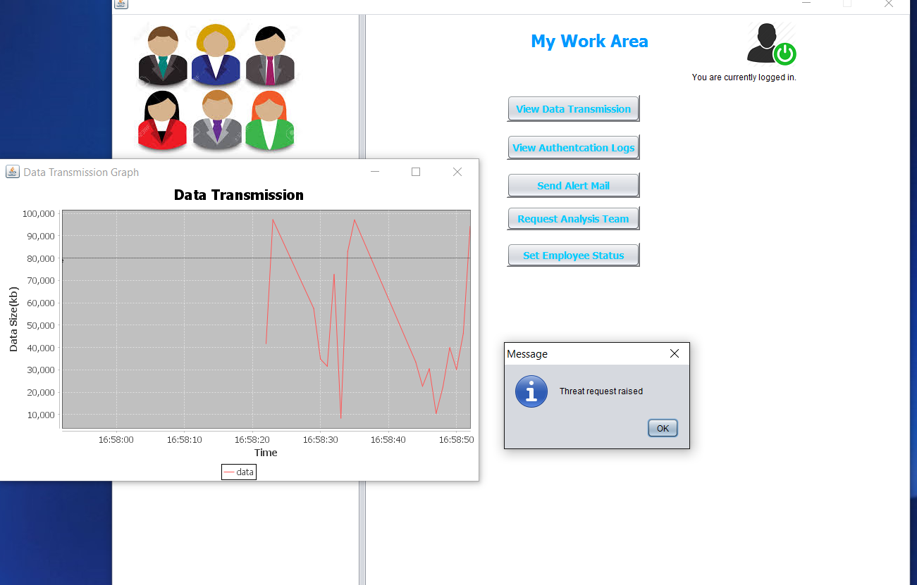
Pop up messages or alerts depending upon the threshold of data transmission

Slide 13
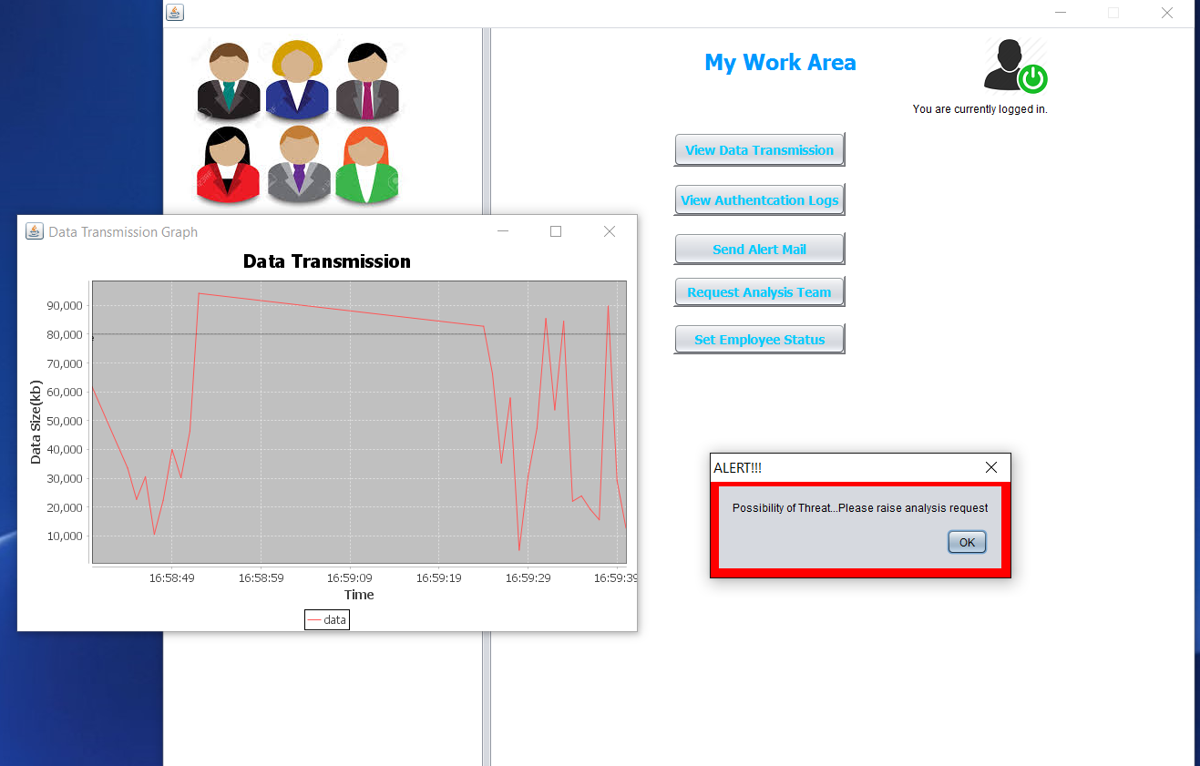

Slide 14
Thank you

